Slide 1

Car Model Reviews With Sentiment Analysis
Theodore Koby-Hercsky Presentation Link: https://youtu.be/XXjVLOkLeXE

Slide 2
Agenda
1. Introduction
2. Business Problem & Primary Goal
3. Data Background
4. Data Exploration
5. Natural Language Processing
6. Visualizations
7. Modeling
8. Summary

Slide 3

Introduction
Can choosing your next car sometimes seem stressful?
Yes, it can. Throughout this presentation we will be going over the steps one can take with sentiment analysis to get a better understanding of the reviews they are working with.

Slide 4

Business Problem
Customers have many options and brands to choose from when purchasing their next vehicle.
Primary Goal
Provide customers with ease of mind when researching brands, they are interested in for their next vehicle through sentiment analysis.
4

Slide 5
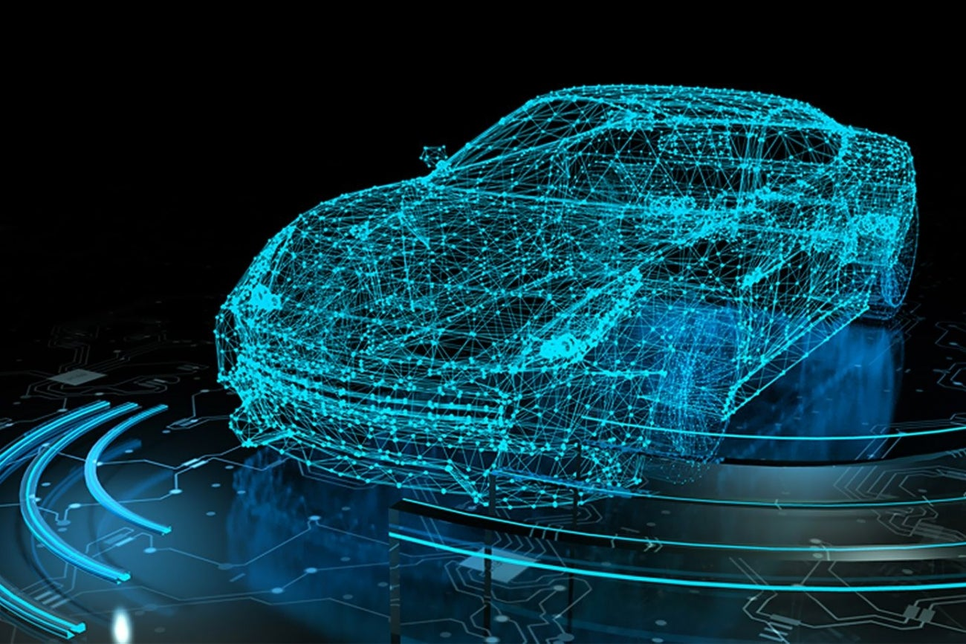
Background on Data
Five Variables
Rating
Car Year
Brand Name
Date
Review
Five Car Brands
Audi
Lexus
Infiniti
BMW
Mercedes-Benz

Slide 6
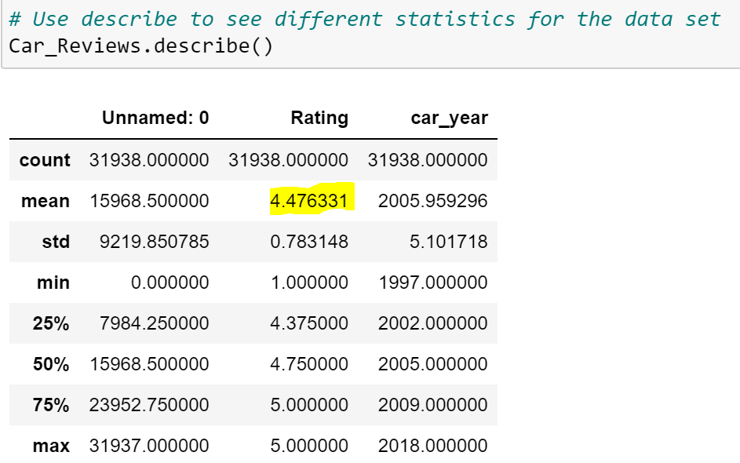
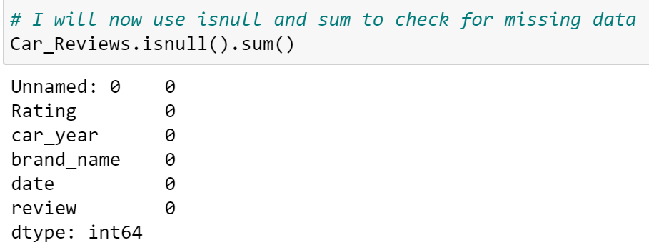
Data Exploration
Isnull() Function
Isnull() – “detects missing values for an array-like object.” (Pandas)
Isnull detected no missing values
Describe Method
Describe - “method returns description of the data in the DataFrame” (W3School)
Mean rating of 4.47

Slide 7
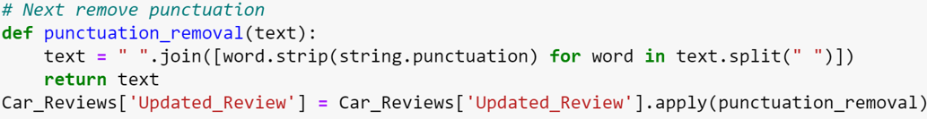
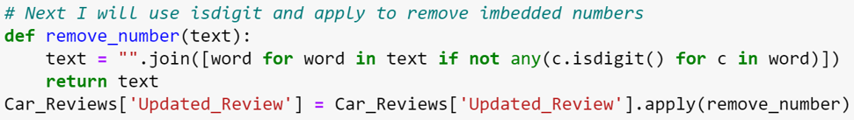
Natural Language Processing
NLP – “goal is to make computers understand the unstructured text and retrieve meaningful pieces of information” (Iriondo)
Implement Lowercase
Punctuation Removal
Remove Imbedded Numbers

Slide 8
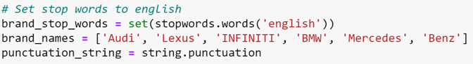
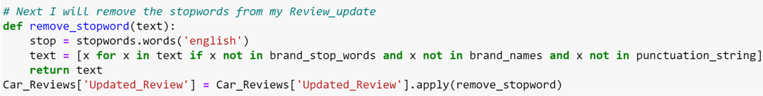
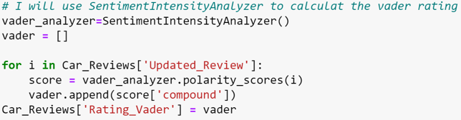
Natural Language Processing
Stop Word – The removal of words such as “if”, “but”, and “or”
Removal of Stop words
Vader Rating
Create in-depth rating and Vader Polarity indicating positive, negative, and neutral reviews.

Slide 9
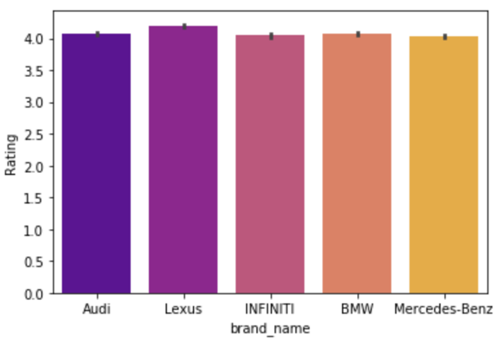
Visualization
Average Rating By Brand
Seaborn Barplot
The average rating for all brands have an average rate of 4 out of 5.
Lexus shows a rating compared to the other brands while Mercedes-Benz showed the lowest average rate.

Slide 10
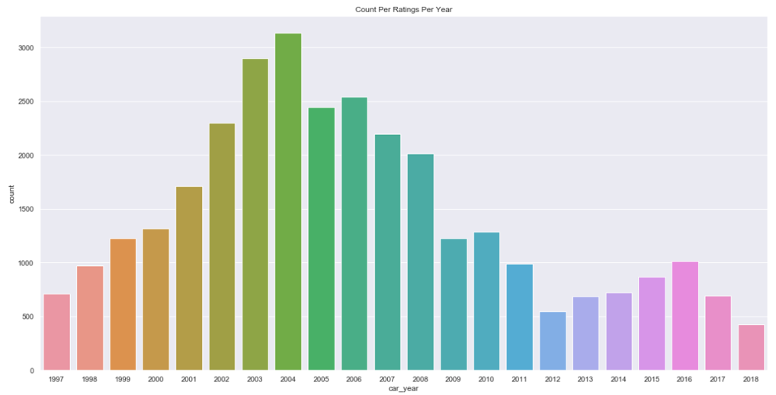
Visualizations
Rating Count Per Year
Seaborn Countplot
Over 3,000 reviews in 2004 for all car brands.
2018 had less than 500 reviews for all car brands.

Slide 11
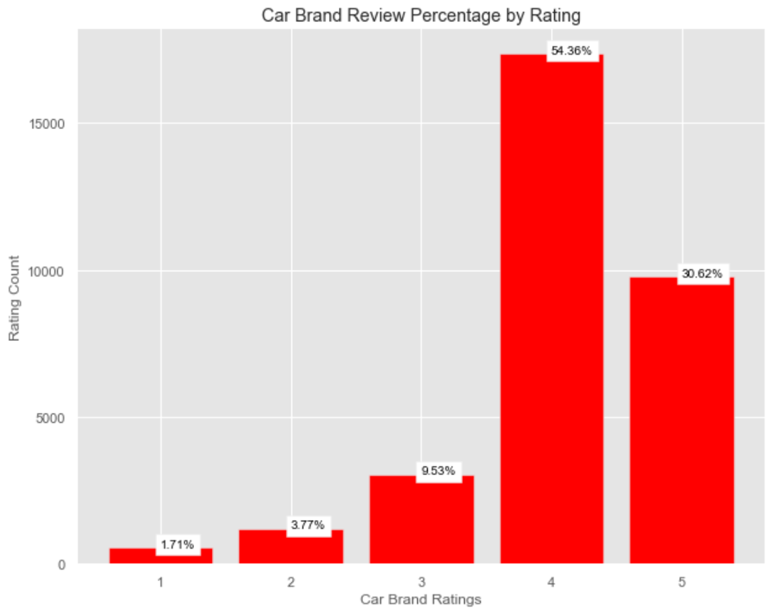
Visualization
Matplotlib Bar Plot
Rating variable showed 84.98% of reviews coming in at a 4 and a 5.
Only 15.01% of reviews are for rating of 1 through 3

Slide 12
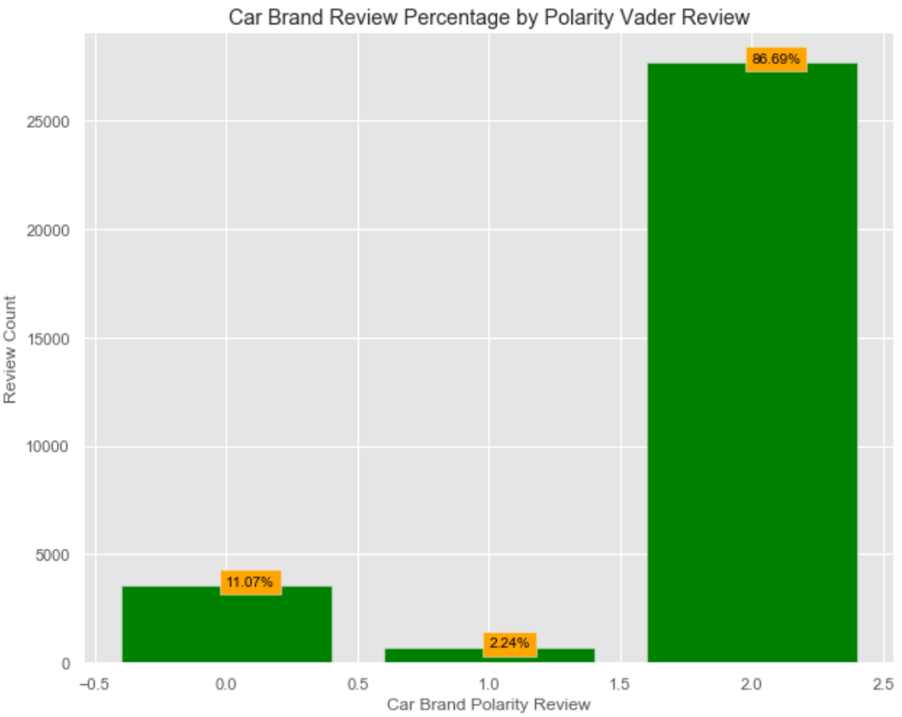
Visualizations
Matplotlib Bar Plot
Polarity Vader Review variable showed 86.96% in positive ratings.
Negative ratings accounted for 11.07% and neutral ratings accounted for only 2.24%
Negative and neutral ratings combined account for 13.31%

Slide 13
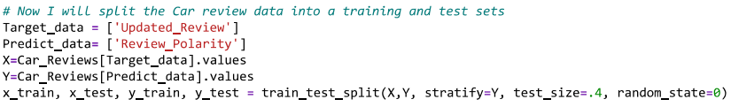
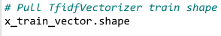
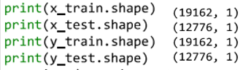
Modeling
Setting X and Y
X value
Set to the Updated Review
Y value
Set to the Review Polarity
TFIDF Vectorizer X Train
Term Frequency – Inverse Document Frequency
“Statistic that aims to better define how important a word is for a document.” (Borcan)
X Train Vector
Shape: 19,162 and 21,980

Slide 14
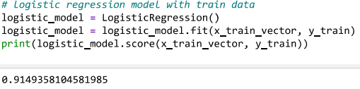
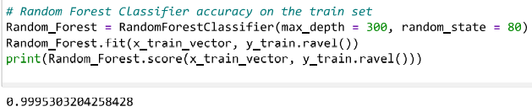
Modeling
Random Forest Analysis - Is a “supervised learning algorithm that can be used both for classification and regression and is flexible and easy to use.” (Navlani)
Random Forest Accuracy
99.95% Accuracy
Logistic Regression – Used to “solve classification problems by predicting categorical outcomes.” (W3Schools)
Regression Accuracy
91.49% Accuracy

Slide 15
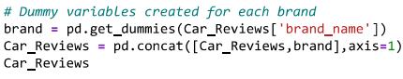
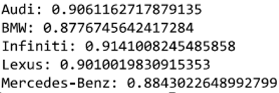
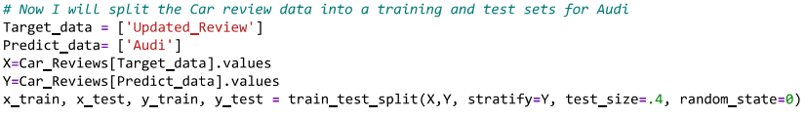
Brand Modeling
Dummy Variables – Created for all five brands.
Logistic Regression – Created for all brands
Highest Accuracy Infiniti at 91.41%
Lowest Accuracy BMW 87.77%
Training and Test Sets– Implemented for all five brands.

Slide 16
Modeling Overview
Review Polarity Variable models
Random Forest Model
99.95% Accuracy
Logistic Regression
91.49% Accuracy
Dummy Variables for each Brand models
Logistic Regression
Infiniti highest Accuracy 91.41%
BMW lowest Accuracy 87.77%

Slide 17
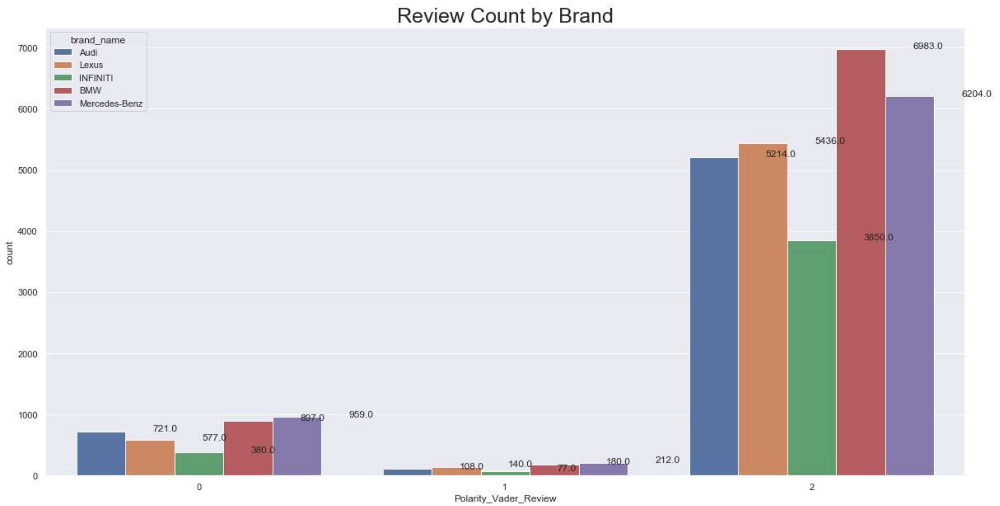
Summary
Overall, all models showed interesting statistics, but the original two models created deemed most accurate.
Review Polarity variable models deemed best choice
Random Forest Accuracy 99.95%
Logistic Regression Accuracy 91.49%
Dummy variable Logistic Regression models next best
Infiniti 91.41%
Audi 90.61%
Lexus 90.10%
Mercedes 88.43%
BMW 87.77%
Recommendation
Brands to research further
BMW, Lexus, Audi
Showed some of the highest positive reviews and are deemed great choices for a next vehicle

Slide 18
Citations
W3Schools. (n.d.). Pandas DataFrame describe() Method. Pandas dataframe describe() method. Retrieved January 22, 2023, from https://www.w3schools.com/python/pandas/ref_df_describe.asp
Pandas isnull() function. w3resource. (n.d.). Retrieved January 22, 2023, from https://www.w3resource.com/pandas/isnull.php#:~:text=The%20isnull()%20function%20is,arrays%2C%20NaT%20in%20datetimelike).&text=Object%20to%20check%20for%20null%20or%20missing%20values
Iriondo, R. (2021, October 22). Natural language processing (NLP) with python - tutorial&nbsp;. Towards AI. Retrieved January 29, 2023, from https://towardsai.net/p/nlp/natural-language-processing-nlp-with-python-tutorial-for-beginners-1f54e610a1a0
Borcan, M. (2020, June 8). TF-IDF explained and python sklearn implementation. Medium. Retrieved January 25, 2023, from https://towardsdatascience.com/tf-idf-explained-and-python-sklearn-implementation-b020c5e83275
W3Schools. (n.d.). Machine learning - logistic regression. Python Machine Learning - Logistic Regression. Retrieved January 25, 2023, from https://www.w3schools.com/python/python_ml_logistic_regression.asp
Navlani, A. (2018, May 16). Sklearn Random Forest classifiers in python tutorial. DataCamp. Retrieved January 25, 2023, from https://www.datacamp.com/tutorial/random-forests-classifier-python

